Slide 1
MSc AI for marketing strategy
Customer Relationship Management
Session #2
Robert Fonteijn

Slide 2
In bold, the students who are on the ‘official’ list of participants
Eduardo de La Espriella
Haozhe Tang
Henri Garcia Pelayo
Ines Cerne
Angelina Andreeva
Yara N
Shrawan SB
Enzo N’Koma
Van Than Duan
Chloé Doinel
Julie Jynetta Joseph
Yuanyuan Liu
Malek Zannad
John Joseph Anthony
Ruthvik Ravish

Slide 3
Breaking news
This January was 2.2C hotter in Europe than the 1991-2020 average, according to Copernicus, the European Earth observation agency. Bloomberg
Question: the workers who are getting laid off from big tech companies, will they go back to working at tech companies, or will they migrate to other industries that need tech talent ? I think a greater distribution of engineering / tech talent across industries might deliver some productivity gains.

Slide 4

A work opportunity
CleverValues is a start-up, focused on value-based marketing, based on a platform that enables companies to position their products in terms of the value they represent for their clients. It’s sort of automated consulting.
MVP has been developed. Now it’s time to go to stage 2, which will integrate a number of functionalities using big data and AI.
The job is to support the development of a technical roadmap for the next-level functionalities, including:
Final choice and management of the algorithms (data analysis and AI) – including data scraping, parsing, NLP, decision aids …)
Working with the CTO and the lead developer to incorporate these functionalities and making the appropriate architecture choices.
(Being a start-up, work will also involve a bit of webmastering of the platform).
I know the founders / main people involved well. They’re very good people to work with. If any of you is intersted, I’ll arrange contact.

Slide 5

Agenda for this S2
What do you remember of last time?
Preparation work for today
Business strategy: exercises
Work for next time

Slide 6
We talked context : the 2020s are a period of transitions
In the business world generally.
In terms of organisation models.
In terms of managerial activities.
We also discussed:
Some tech trends.
What is currenty going on ?
The « great Acceleration ».

Slide 7
We also discussed 3 levels of looking at things
Macro, the Super-system :
The context
Activity – in teams
Do a « zoom in » and a « zoom out » analysis for « CRM »
15’
Meso, the System :
The « object of analysis »
Micro – the Sub-systems : a structured examination of the details of the object
Did we do this last time ?

Slide 8
What you said you wanted to learn here
Apply CRM in marketing
CRM in different businesses
New methods in CRM – future & trends
Steps in development
21stC challenges to managers
x
Anyting to add?

Slide 9
A funnel
In this course, we go from Macro to Micro : a funnel that moves from General Context, to Business Strategy, Marketing Plans and then specifically focus onto Customer Relationship Management.
General context
Business strategy
Marketing
CRM

Slide 10
Overview of sessions 1 - 5
Session & date | Focus
1 – 1st Feb | Business : context
2 – 16th Feb | Strategy – business level
3 – 1st March | Strategy – marketing
4 – 8th March | Operations – marketing & CRM
5 – 15th March | Supporting CRM in organsations
What’s the thinking behind the sequence ?

Slide 11
Work for today
Read, be able to sum up, and formulate questions:
« Generative AI – how will the new era of machine learning affect you? » https://www.ft.com/content/1e34f334-4e73-4677-9713-99f85eed7ba0.
The care of one : hyperpersonalisation of customer care. McKinsey&Co
Download « mckinsey-tech-trends-outlook-2022-full-report.pdf » and read pages 20 – 32 on the subject of Applied AI – and any other pages you feel are of interest to you..

Slide 12
« Care of one » : a few questions
What is « experience-oriented customer care?
What is a « customer journey »? *
What does it take to deliver personalised care ?
What is omnchannel communication and why are we interested ?
Why is white-glove service « inevitable »?

Slide 13
The journey
Awareness - discover
Consideration - evaluate
Decision - buy
Experience - use
Loyalty – buy more & often
Advocacy - bond

Slide 14
Today : a few exercises around company strategy
The canvas
Key Success Factors
The importance / performance logic
Three time horizons
The competitive profile

Slide 15
Last time, we talked about the Canvas
Activities
Channels
The value
proposition
Partnerships
Client
segments
Capabilities
Relationships
Cost structure
Revenue streams

Slide 16

Activity #1 – in teams
Research freitag.ch/en
Define the value proposition (3 parts)
Define the Capabilities (detail the 5 categories) to the extent you know them.
Please come back with new questions.
PS:
An additional question: What information do you not have – and how do you deal with that situation ?
20’

Slide 17
Reminder: the 7 boxes and 2 breakdowns
Value proposition
Channels
Relationships
Clients
Activities
Capabilities
Partnerships
Product characteristics
Benefits
« Experience »
Knowledge
Skills
Design
Technology
Structure

Slide 18
Activity #2 – in teams
Identify which of the capabilities are incuded in what you might call ‘Key Success Factors’ for Freitag : the primary reasons behind the success of their business.
BTW, Why did you choose the ones you chose?
15’

Slide 19
KSFs : areas to consider include:
Capabilities:
Knowledge
Skills
Design
Technology
Structure
Resources, incl access to finance
Innovation
Operational efficiency
Marketing, incl customer loyalty and data management

Slide 20
Some more detailed KSFs
Market share | Rel’ships with unions | Power over suppliers
Product quality | Skilled workforce | Access to key suppliers
Clear strategic direction | Location of facilities | Efficient supply chain
Customer service | Customer loyalty | On-time delivery
Added product features | Brand reputation | Strong online presence
Price competitiveness | Customer satisfaction | Low cost structure
Effective social media marketing | Variety of products | Financial position
Innovative culture | Employee retention | Etc

Slide 21
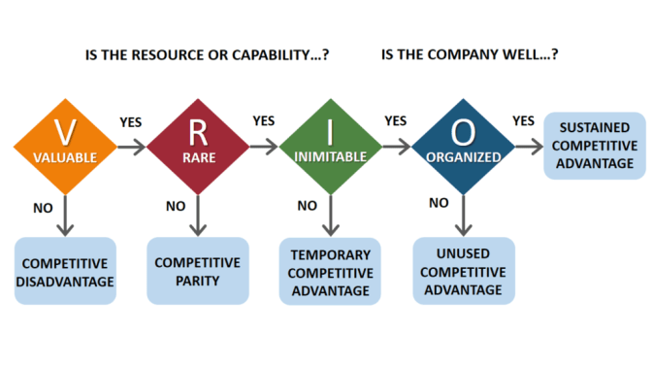
This is where VRIO analysis comes in

Slide 22
Activity #3 – in teams
List a selection of KSFs in a table (format on next slide).
Decide on « Importance » and « Performance », i.e. « How important is this factor in the continuing success of the business »?
Comment on your findings.
20’

Slide 23
KSFs | Impor-tance | Perfor-mance | Comments
1
2
3
4
5
6
7 etc
Scale 1 – 5, where:
5 = High
1 = Low

Slide 24
Feedback
KSFs | Impor-tance | Perfor-mance | Comments
1
2
3
4
5
6
7 etc

Slide 25
Three time horizons in business strategy
Performance
potential
3. Longer term: Create viable options
2. Medium term: Build emerging businesses
1. Short term: Extend and defend core business
Time

Slide 26
Activity #4 – in teams
What should be the main areas of focus, in your view, in the three time horizons for Freitag ?
15’

Slide 27
Three time horizons
3. Longer term:
Performance
potential
2. Medium term:
1. Short term:
Time

Slide 28
Activity #5 – in teams
What are Freitag’s main drivers of internationalisation ?
20’

Slide 29
Drivers of internationalisation
Market drivers
Similar customer needs
Global customers
Transferable marketing
Government drivers
Trade policies
Techncal standards
Host government policies
Cost drivers
Scale economies
Country-specific differences
Favourable logistics
Competitive drivers
Interdependence between countries
Competitors’ global strategies

Slide 30


Next time, 1st March
Read and formulate questions:
« The Human – Tech Equation for Improving Marketing ROI » | BCG.
Explore clickz.com and identify an article that you find of interest. Be ready to share the ‘why’ and ‘what’ of your selection with your classmates next session.

Slide 31

Feedback ?
Your reaction after this second session
“WWW” – What Worked Well
“EBI” – Even Better If

